Slide 1
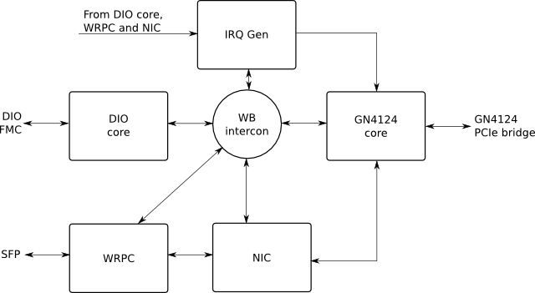
White Rabbit Network Interface Card
This project is concerned with the development of gateware and software to make the combination of a SPEC and a DIO mezzanine behave as a Network Interface Card (NIC) under Linux.

Slide 2
White Rabbit Network Interface Card II
* The DIO core allows configuration of each one of the 5 channels of the DIO mezzanine as input or output. For inputs, it provides an accurate UTC time stamp (using UTC from the WRPC, not shown in the diagram) and a host (PCIe) interrupt via the IRQ Gen block. For outputs, it allows the user to schedule the generation of a pulse at a given future UTC time, or to generate it immediately.
* The IRQ Gen block receives one-tick-long pulses from other blocks and generates interrupt requests to the GN4124 core. It also includes interrupt source and mask registers.
* The WB intercon block ensures seamless interconnection of Wishbone masters and slaves using a crossbar topology.
* The GN4124 core is a bridge between the GN4124 PCIe interface chip and the internal Wishbone bus, allowing communication with the host and interrupts.

Slide 3
White Rabbit Network Interface Card III
* The WRPC (White Rabbit PTP Core) communicates with the outside world through the SFP socket in the SPEC, typically using fiber optics. It deals with the WR PTP using an internal LM32 CPU running a portable PTP stack. It forwards/receives non-PTP frames to/from the NIC block, using two pipelined Wishbone interfaces (master and slave for forwarding and receiving respectively). It also provides UTC time to other cores (not represented in the diagram), and time-tags for transmitted and received frames that can be read through Wishbone for diagnostics purposes.
* The NIC core ensures communication between the host and the WRPC. More precisely, it interrupts the host and provides a descriptor that the host can use to fetch incoming frames. For outgoing frames, it receives a descriptor from the host, fetches the frame using PCIe DMA via the GN4124 core and sends it to the WRPC using a pipelined Wishbone interface.

Slide 4
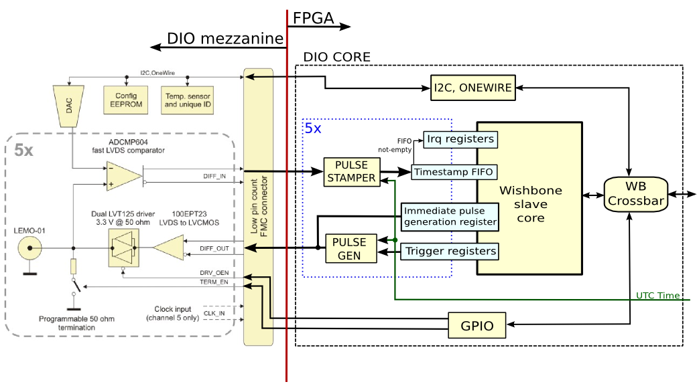
DIO core architecture

Slide 5
DIO core architecture II
Modules to configure each single-bit port:
  GPIO. It allows to enable or disable the output drivers and the termination resistors.
  I2C. It allows to set the threshold of the ADCMP604 fast LVDS comparator and to access to write/read data to the EEPROM memory (24AA64).
Modules to generate or tag pulses:
  Pulse generator which produces a 1-tick-long pulse in its output when the UTC time passed to it through a vector equals a pre-programmed UTC time.
  Pulse stamper which associates a time-tag with an asyncrhonous input pulse.
  Wishbone slave core which has been generated by wbgen2 tool. This core implement a wishbone bus slaves with:
    Trigger registers (UTC-time-based for pulse generation),
    FIFOs, to store the timestamps,
    Interrupt registers, to configure the interrupts witch are generated when there are data in the FIFOs.
    Monostable register, which generates a single clock cycle-long positive pulse when 1 is written to it. It is used to generate a single pulse on the output immediately.

Slide 6
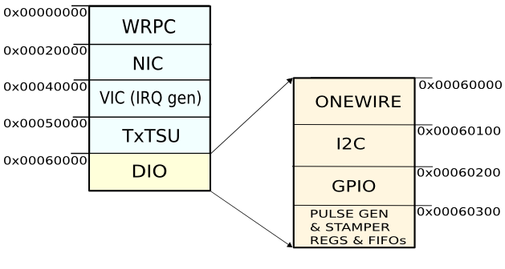
DIO core memory map
Within that memory space, the DIO core has mapped each one of the different modules that make up its architecture. Furthermore, any address within this memory space may be addressed by the PC to configure that modules (Onewire, I2C, GPIO ...).

